Slide 1


Christopher Esteves
12/11/2022

Slide 2

Outline
Executive Summary
Introduction
Methodology
Results
Conclusion
Appendix

Slide 3
Executive Summary
Summary of methodologies
Data Collection through API
Data Collection with Web Scraping
Data Wrangling
Exploratory Data Analysis with SQL
Exploratory Data Analysis with Data Visualization
Interactive Visual Analytics with Folium
Machine Learning Prediction
Summary of all results
Exploratory Data Analysis result
Interactive analytics in screenshots
Predictive Analytics result

Slide 4
Introduction
Project background and context
Space X advertises Falcon 9 rocket launches on its website with a cost of 62 million dollars; other providers cost upward of 165 million dollars each, much of the savings is because Space X can reuse the first stage. Therefore, if we can determine if the first stage will land, we can determine the cost of a launch. This information can be used if an alternate company wants to bid against space X for a rocket launch. This goal of the project is to create a machine learning pipeline to predict if the first stage will land successfully.
Questions that need to be addressed:
What factors are useful in determining if a rocket will successfully land?
Which correlation can be obtained from these factors to influence these successes?
What operating conditions needs to be in place to ensure a successful landing program?

Slide 5

Section 1

Slide 6
Methodology
Executive Summary
Data collection methodology:
Data from SpaceX API and Wikipedia through the use of web scraping.
Perform data wrangling
One-hot encoding was applied to categorical features
Perform exploratory data analysis (EDA) using visualization and SQL
Perform interactive visual analytics using Folium and Plotly Dash
Perform predictive analysis using classification models
How to build, tune, evaluate classification models

Slide 7
Data Collection
Methodologies:
Data collection was done using get request to the Space X API.
Web-scraping from Wikipedia for Falcon 9 launch records was through the use of BeautifulSoup API.
Context was transferred as a json and data frame through utilizing .json() function and .json_normalize().
Data was cleaned, verified for missing variables, and null values were averaged or omitted dependent on the need where data would not be affected; to then be written into a table which could then be further reviewed and manipulated with python and sql coding.

Slide 8
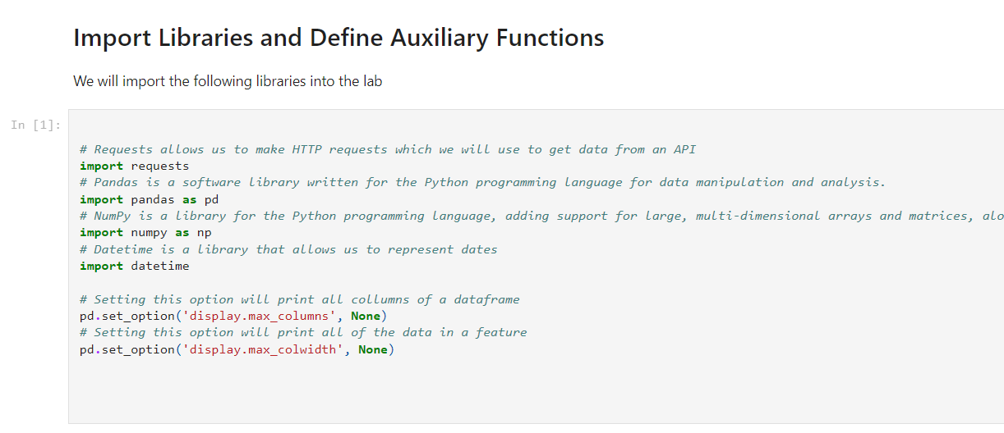
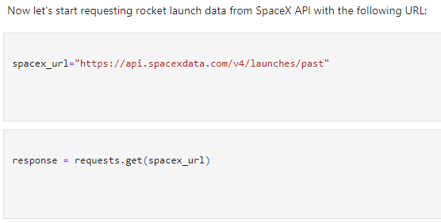
Data Collection – SpaceX API
Below is the method that I used to input the API along with associated terms.
But api is set to a variable which we then are able to parse information
https://github.com/cestevespr/IBM-final/blob/main/jupyter-labs-spacex-data-collection-api%20(1).ipynb

Slide 9
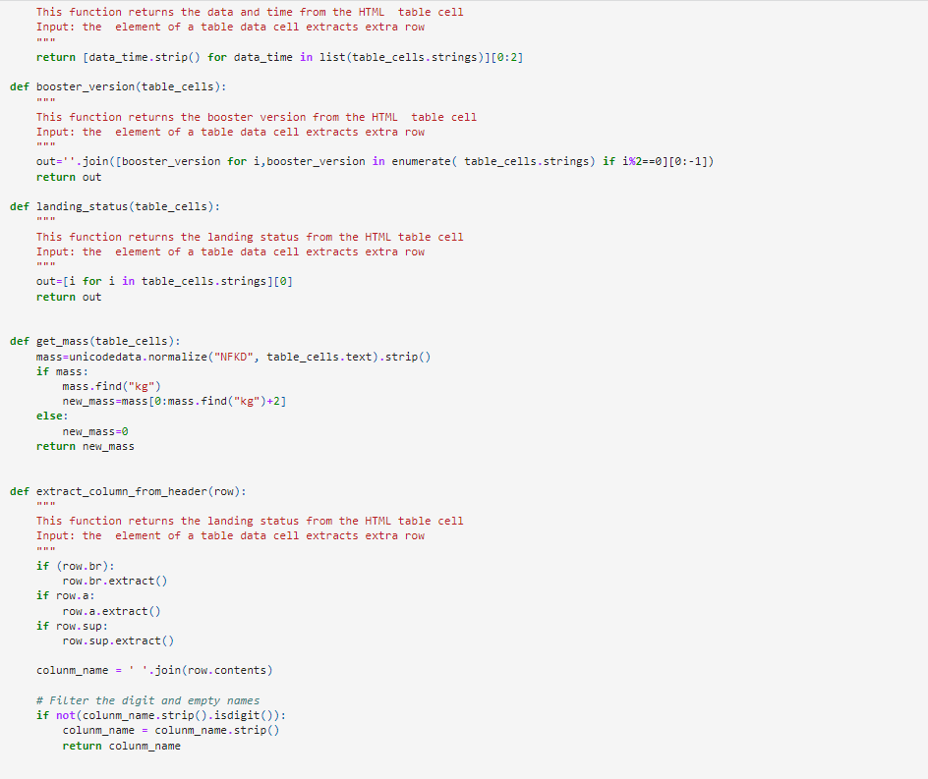
Data Collection - Scraping
Utilizing the following code we are able to pull the strings of multiple variables and then transpose them on to a workable table.
https://github.com/cestevespr/IBM-final/blob/main/jupyter-labs-webscraping.ipynb

Slide 10
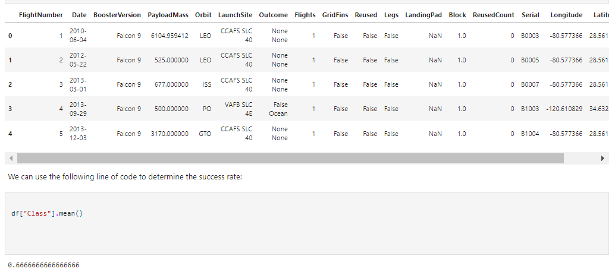
Data Wrangling
Processing data:
Apply value_counts() on LaunchSites and Orbits
df['LaunchSite'].value_counts()
df['Orbit'].value_counts()
Also developed landing outcomes in relation to these factors
landing_class= []
for row in df['Outcome']:
if row in bad_outcomes:
landing_class.append(0)
else:
landing_class.append(1)
https://github.com/cestevespr/IBM-final/blob/main/IBM-DS0321EN-SkillsNetwork_labs_module_1_L3_labs-jupyter-spacex-data_wrangling_jupyterlite.jupyterlite.ipynb

Slide 11
EDA with Data Visualization
Exploration of the data showing the relationship between flight number/ launch Site, payload/launch site, success rate of each orbit type, flight number/orbit type, the launch successes per year.
https://github.com/cestevespr/IBM-final/blob/main/IBM-DS0321EN-SkillsNetwork_labs_module_2_jupyter-labs-eda-dataviz.ipynb.jupyterlite%20(1).ipynb

Slide 12
EDA with SQL
Wrote queries to find out for instance:
The names of all distinct launch sites in the space mission.
The total payload mass carried by boosters launched by NASA
The average payload mass carried by the specified booster model: F9 v1.1
The breakdown of the successful and failed mission outcomes
Failed landings on drone ship; along with their booster version and location of launch.

Slide 13
Build an Interactive Map with Folium
We marked all launch sites, and added map objects such as markers, circles, lines to mark the success or failure of launches for each site on the folium map.
We assigned the feature launch outcomes (failure or success) to class 0 and 1.i.e., 0 for failure, and 1 for success.
Using the color-labeled marker clusters, we identified which launch sites have relatively high success rate.
We calculated the distances between a launch site to its proximities. We answered some question for instance:
Are launch sites near railways, highways and coastlines.
Do launch sites keep certain distance away from cities.
The link to the notebook is https://github.com/cestevespr/IBM-final/blob/main/IBM-DS0321EN-SkillsNetwork_labs_module_3_lab_jupyter_launch_site_location.jupyterlite.ipynb

Slide 14
Build a Dashboard with Plotly Dash
Built an interactive dashboard with Plotly dash
Plotted pie charts showing the total launches by a certain sites
We plotted scatter graph showing the different relationships from payload, location, and orbit to discern to landing percentages.
The link to the notebook is https://github.com/cestevespr/IBM-final/blob/main/IBM-DS0321EN-SkillsNetwork_labs_module_2_jupyter-labs-eda-dataviz.ipynb.jupyterlite%20(1).ipynb

Slide 15
Predictive Analysis (Classification)
We parsed the data using numpy, seaborn, scikit, and pandas, transformed the data, by randomly splitting our data into training and testing environments.
We built different machine learning models and fine tuned them through the usage of different python API’s.
We worked toward finding the best accuracy and utilized that as the metric for our testing. We also improved the model using feature engineering and different algorithm manipulation.
The link to the notebook is https://github.com/cestevespr/IBM-final/blob/main/IBM-DS0321EN-SkillsNetwork_labs_module_4_SpaceX_Machine_Learning_Prediction_Part_5.jupyterlite.ipynb

Slide 16
Results
Exploratory data analysis results
Interactive analytics demo in screenshots
Predictive analysis results

Slide 17

Section 2

Slide 18

Flight Number vs. Launch Site
From the plot, we found that the larger the flight amount at a launch site, the greater the success rate at a launch site.

Slide 19

Payload vs. Launch Site
From the plot, we found that the larger the flight amount at a launch site, the greater the success rate at a launch site.

Slide 20
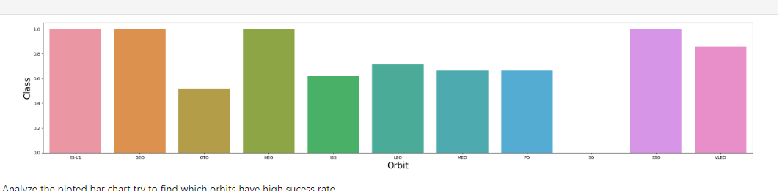
Success Rate vs. Orbit Type
From the plot, we can see that ES-L1, GEO, HEO, SSO, VLEO had the most success rate.

Slide 21

Flight Number vs. Orbit Type
We observe that in the LEO orbit, success is related to the number of flights. Conversely, there is no relationship between flight number and orbit for the GTO.

Slide 22

Payload vs. Orbit Type
With heavy payloads, the successful landing are more likely for PO, LEO and ISS orbits

Slide 23
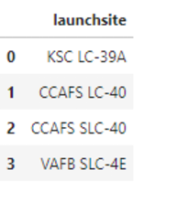
All Launch Site Names
All of the unique launch sites
%sql select * from SPACEXTBL where LAUNCH_SITE like 'CCA%' fetch first 5 row only

Slide 24
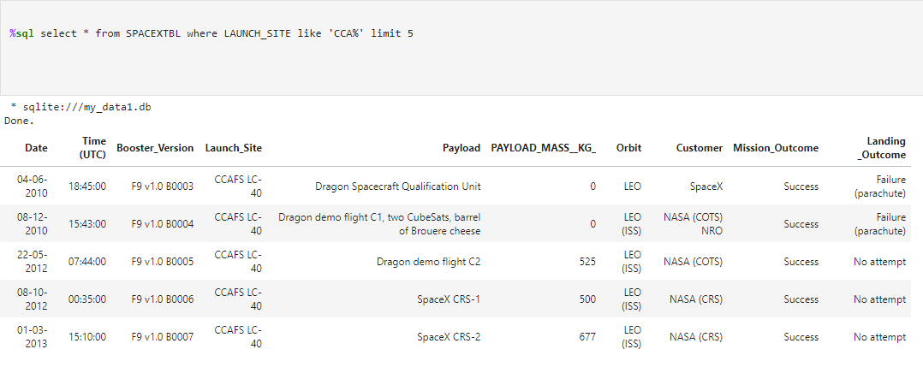
Launch Site Names Begin with 'CCA'
5 records where launch sites begin with `CCA`

Slide 25
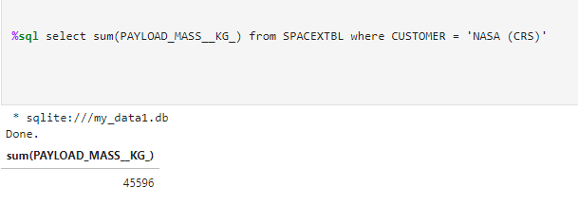
Total Payload Mass
Total payload mass is 45596
%sql select sum(PAYLOAD_MASS__KG_) from SPACEXTBL where CUSTOMER = 'NASA (CRS)'

Slide 26
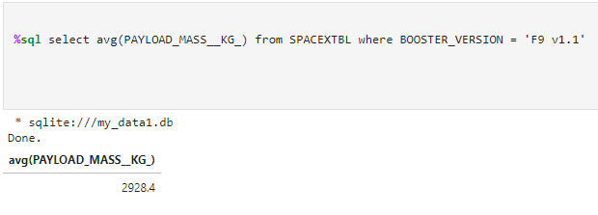
Average Payload Mass by F9 v1.1
Average payload Mass is 2928.4 Kg
%sql select avg(PAYLOAD_MASS__KG_) from SPACEXTBL where BOOSTER_VERSION = 'F9 v1.1'

Slide 27
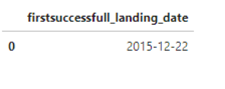
First Successful Ground Landing Date
First successful landing dat is December 22nd, 2015
%sql select min(date) from SPACEXTBL where Landing _Outcome = 'Success (ground pad)'

Slide 28
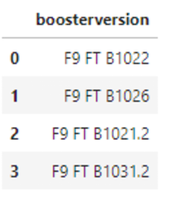
Successful Drone Ship Landing with Payload between 4000 and 6000
We used the WHERE clause to filter for boosters which have successfully landed on drone ship and applied the AND condition to determine successful landing with payload mass greater than 4000 but less than 6000
%sql select BOOSTER_VERSION from SPACEXTBL where LANDING_OUTCOME ='Success (drone ship)' and PAYLOAD_MASS__KG_ BETWEEN 4000 AND 6000

Slide 29
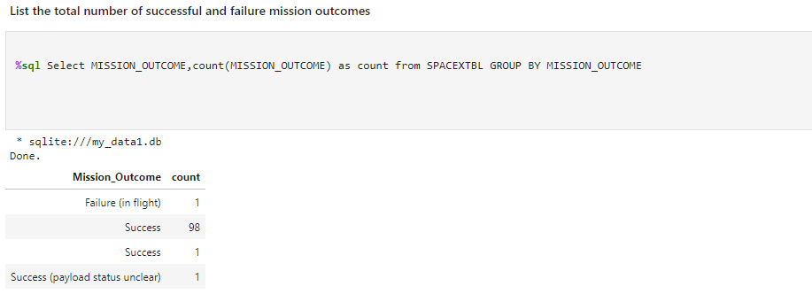
Total Number of Successful and Failure Mission Outcomes
%sql Select Mission_Outcome, count(Mission_Outcome) as count from SPACEXTBL group by Mission_Outcome

Slide 30
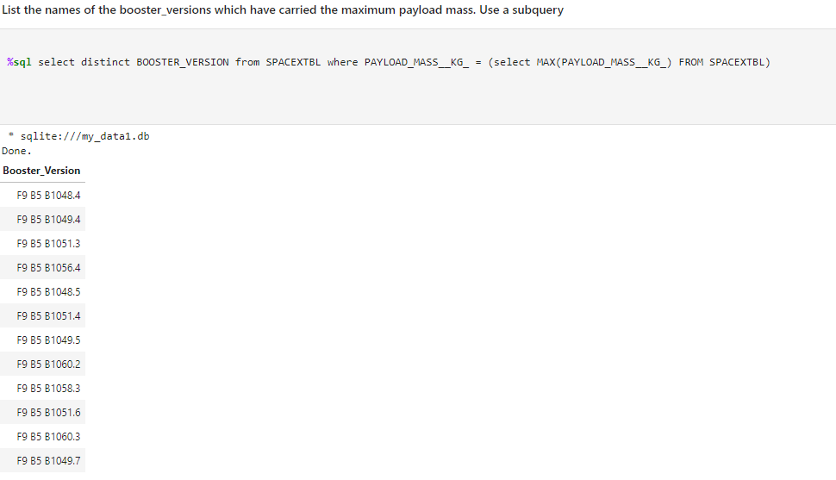
Boosters Carried Maximum Payload
%sql select distinct BOOSTER_VERSION from SPACEXTBL where PAYLOAD_MASS__KG_ = (select MAX(PAYLOAD_MASS__KG_) FROM SPACEXTBL)

Slide 31
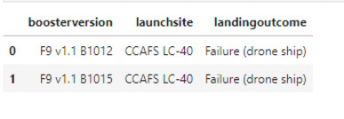
2015 Launch Records
%sql select LANDING__OUTCOME,BOOSTER_VERSION,LAUNCH_SITE from SPACEXTBL where YEAR(DATE) = '2015' and Landing _Outcome = 'Failure (drone ship)'
Output

Slide 32
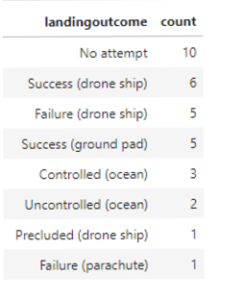
Rank Landing Outcomes Between 2010-06-04 and 2017-03-20
Count of the landing outcomes from the data and filtered it to show the items between: 6/4/2010 to 03/20/2017 and grouped them by the count as shown in the diagram to the right.

Slide 33

Section 3

Slide 34
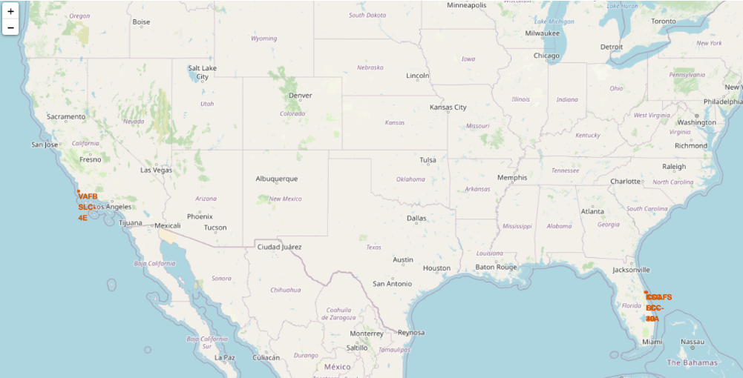
Locations of Launch Sites in the United States
Replace <Folium map screenshot 1> title with an appropriate title
Explore the generated folium map and make a proper screenshot to include all launch sites’ location markers on a global map
Explain the important elements and findings on the screenshot

Slide 35

Launch sites throughout the two locations
Replace <Folium map screenshot 2> title with an appropriate title
Explore the folium map and make a proper screenshot to show the color-labeled launch outcomes on the map
Explain the important elements and findings on the screenshot

Slide 36

Section 4

Slide 37
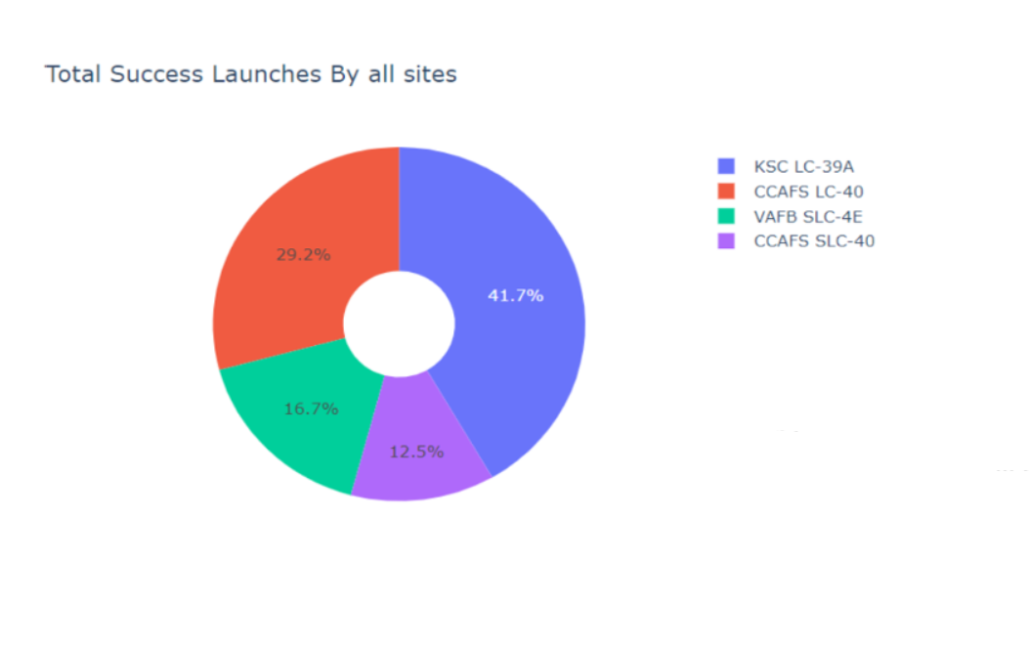
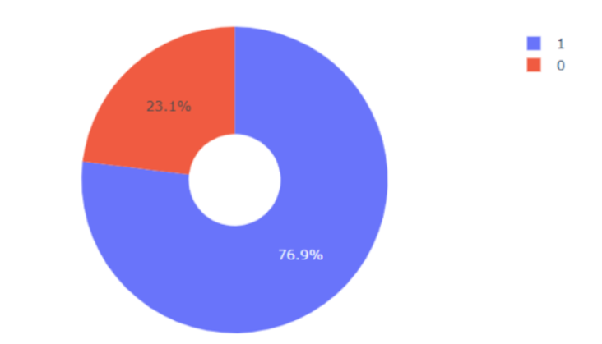
Site Launch Successes
Left diagram shows all the sites precentages.
Right Diagram shows KSC LC-39A which only had a 23.1% failure rate

Slide 38

When looking at this graph we can correlate that there is a high success when the payload is higher

Slide 39
Payload and Success Rate correclation
When looking at this graph we can correlate that there is a high success when the payload is higher

Slide 40

Section 5

Slide 41

Classification Accuracy
The highest accuracy is the Decision Tree model though all models are at an acceptable level

Slide 42
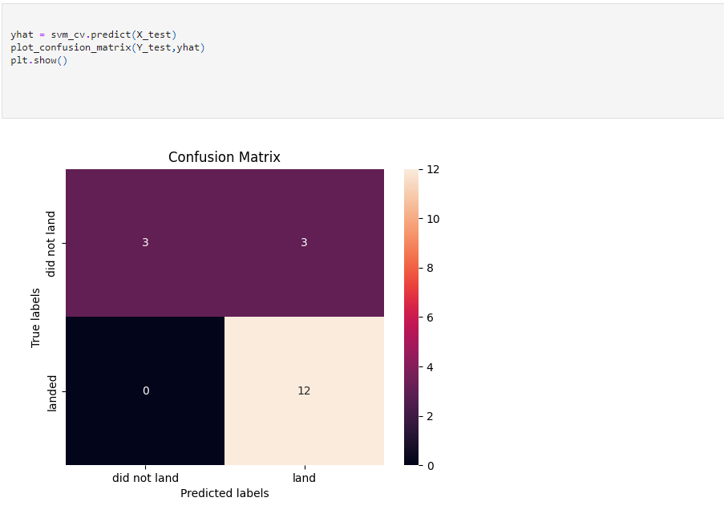
Confusion Matrix
The confusion matrix for the decision tree classifier shows that the classifier can distinguish between the different classes. The major problem is the false positives .i.e., unsuccessful landing marked as successful landing by the classifier.

Slide 43
Conclusions
We can conclude that:
The larger the flight amount at a launch site, the greater the success rate at a launch site.
Launch success rate started to increase in 2013 till 2020.
Orbits ES-L1, GEO, HEO, SSO, VLEO had the most success rate.
KSC LC-39A had the most successful launches of any sites.
The Decision tree classifier is the best machine learning algorithm for this task.

Slide 44


